Slide 1
Jamestown
By Chelsea and Peggy

Slide 2
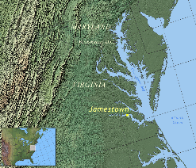
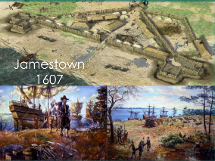
Origins
The colony started on May 14, 1607, when King James funded the Virginia company to settle in Chesapeake, a city in North America.
The entrepreneurs of the Virginia Company were responsible for establishing a secure settlement, as well as seeking gold and a water pathway to the Pacific.

Slide 3
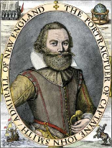
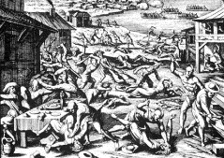
Challenges and changes
A lot of the settlers, who were attacked by Powhatan Indians, died because of starvation, warfare and foreign diseases.
Captain John Smith was extremely strict, which gave him enemies. He had to return to England because he was seriously injured in a gunpowder explosion.
Jamestown’s darkest period, known as the “starving time” started when the Indians sieged James Fort and three hundred settlers stepped in. Only sixty of them survived.

Slide 4
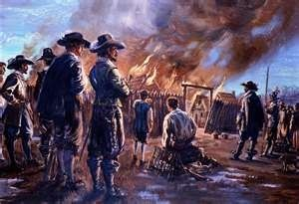
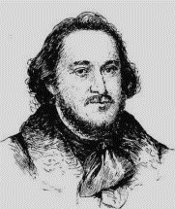
Challenges and changes
Lord De La Ware, the new governor, brought revived the colony.
Jamestown became a town and the original fort disappeared. It was the capital of Virginia until a rebellion burned most of it.
The capital moved to Williamsburg and Jamestown began to decline.

Slide 5
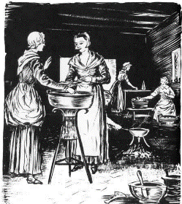
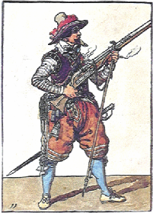
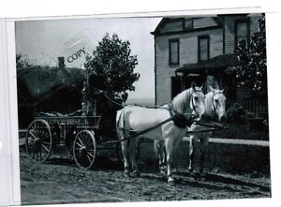
Lifestyle- Daily life
Women
“Indoor duties”
Preparing food, gardening, smoking meat
Men
“Outdoor duties”
Planting crops, building fences, butchering cattle and hogs.
Horse
“Transportation”
$20

Slide 6
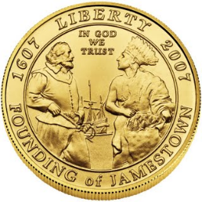


Lifestyle- Daily life
Money
Laborer makes $30 a year
Ham
Their favorite meat.
Morning drink
Cider was their favorite.

Slide 7
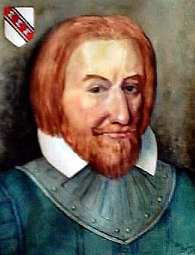
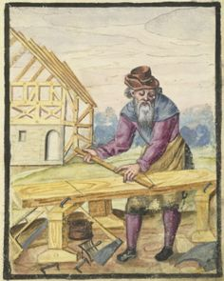
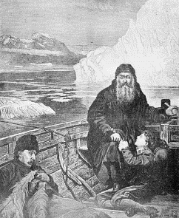
Lifestyle- Jobs
Council
Carpenter
Sailor
Other jobs include: preacher, blacksmith, barber, bricklayer, mason, refiner, surgeon, tradesmen, and laborers.

Slide 8
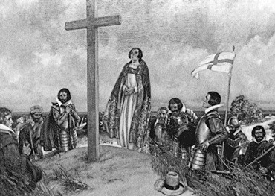
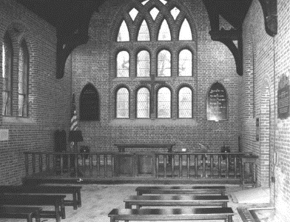
Lifestyle- Religion
Anglicanism, The Church of England

Slide 9
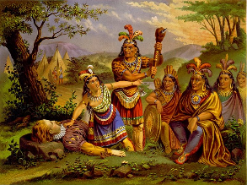
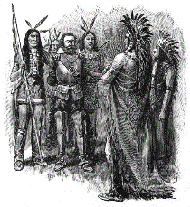
Lifestyle- Interaction
Native Americans
Powhatan Indians
Case #1: Help
Case #2: Let them starve

Slide 10
